Slide 1
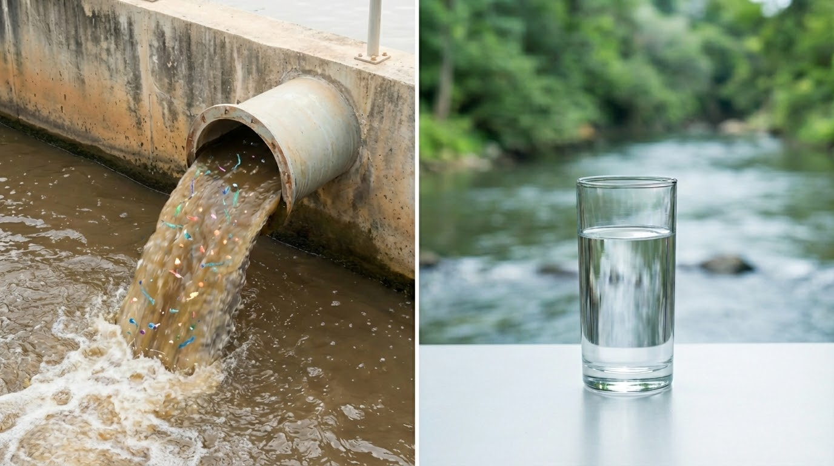
TGAC - 2&3 février 2026
L. BARRITAUD
Territorial Diagnosis of microplastics from wastewater to drinking water

Slide 2





Scientific & Technological Expertise Department
THEMATIC EXPERTS
PROCESS ENGINEERING & CHARACTERIZATION (GP&C)
SCIENTIFIC COMPUTING & MODELING (CSM)
Biological Processes and Characterization
Physical and Chemical Processes and Characterization
Materials
Energy & Gas
Design, production Maintenance Pilots
Bioprocess engineering, Bioconversion, Bioenergy, Materials valorization, …
Microbiology, biomonitoring, Molecular biology, Biotechnology
Physico-chemical processes, Membranes, Drinking water, Modeling, …
Environmental monitoring, Chemical characterization, Sensors
Waste recycling
and recovery, Design - Formulation - Production, …
Building energy services & industries, Local loop, Heat networks, Renewable energy, Combustion, Gas treatments, Air Quality, Modeling, …
Design - Pilot projects, Prototyping, Test platform management, …

Slide 3
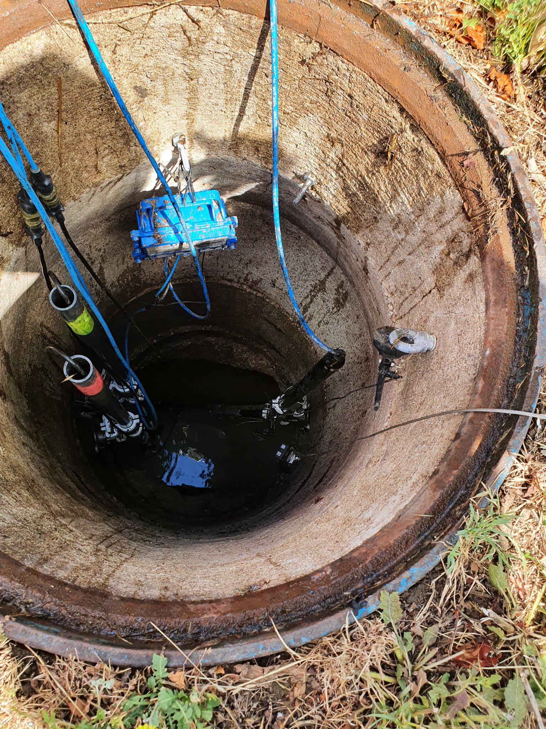
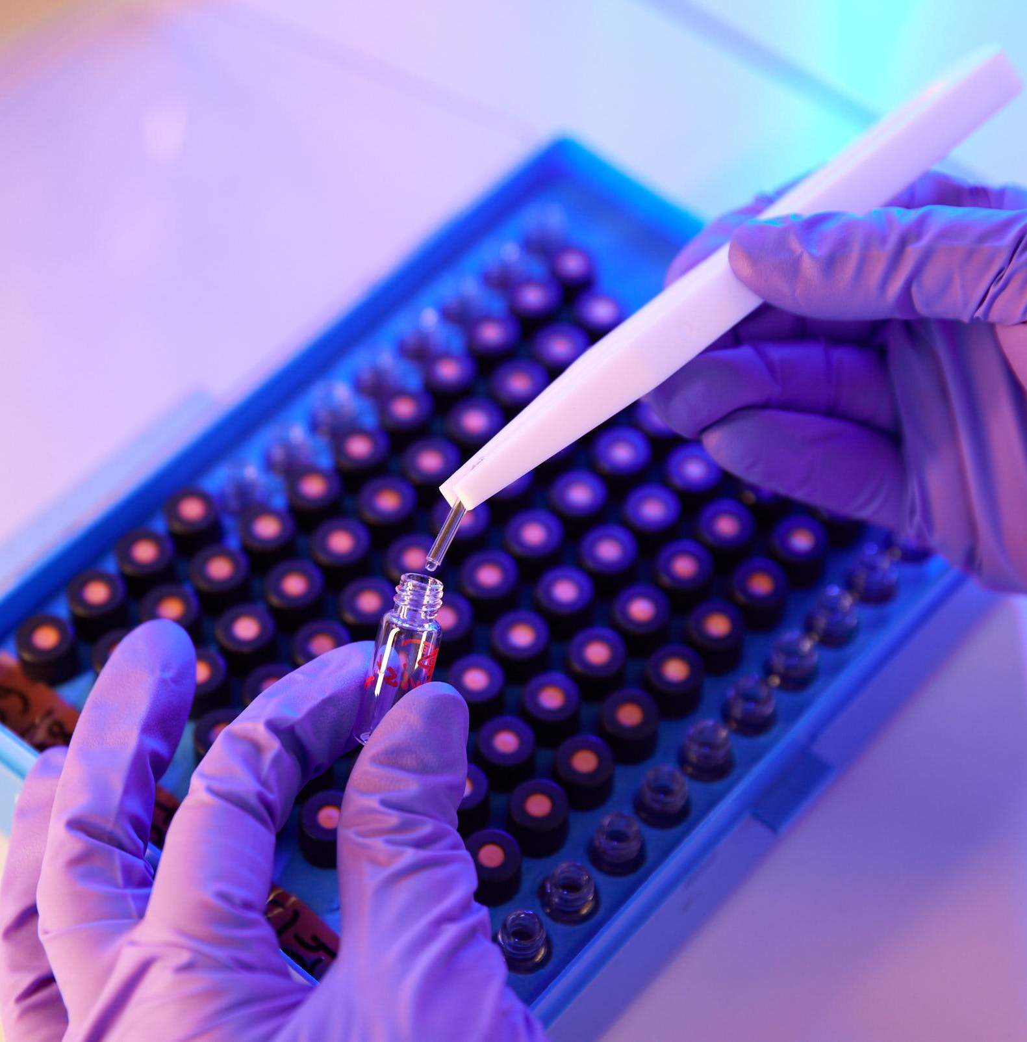
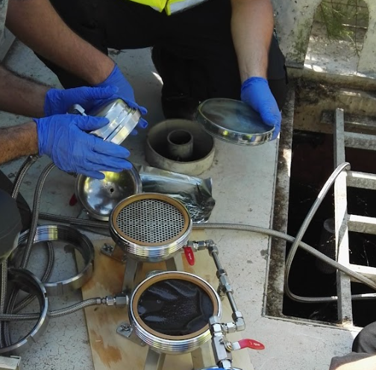
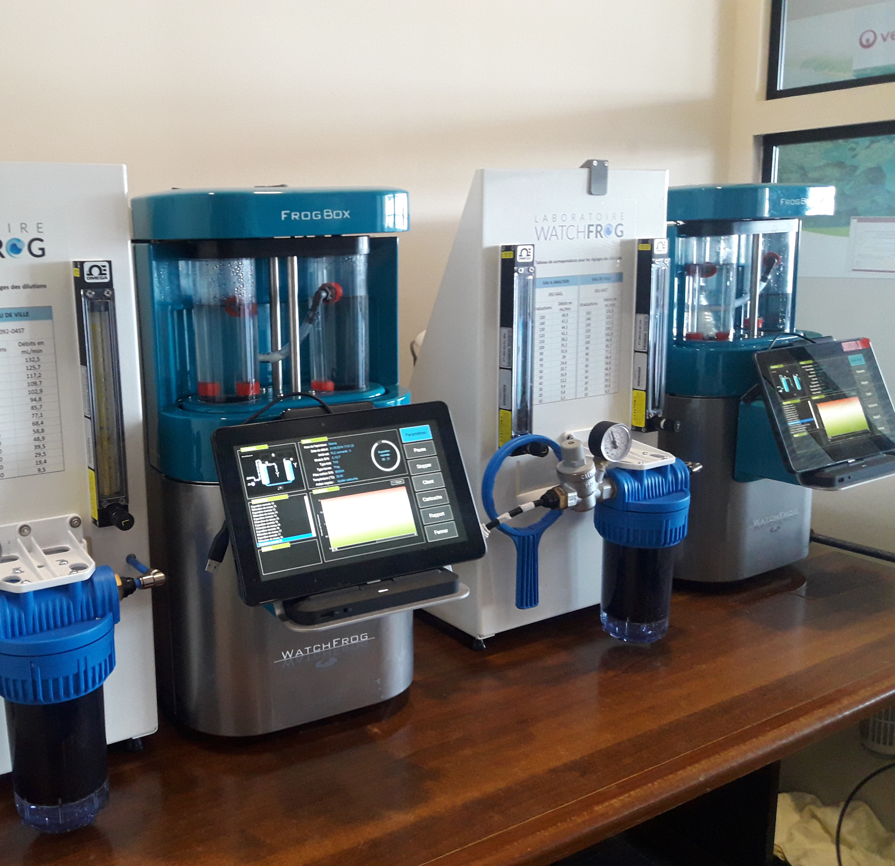
15 Researchers (Ing&Tec)
5 Laboratories
connected with ~ 300 Veolia Labs through Neomab
All Matrices
Liquids, Solids, Gas / Municipal & Industrial
3 Main expertises :
Chemical characterisation
Sensors (On site monitoring)
Sampling
But also
Expertise in ecotoxicology
Key expertises around the
MEASURE
to support BU’s performance and innovation
Key expertises around the
MEASURE
to support BU’s performance and innovation
Organic - chemical footprint
LC-MS, LC-HRMS
GC-HRMS, GCxGC-MS coupled with Pyrolysis, Combustion
…
Inorganic
XRF, DRX, MEB, IC coupled with combustion
> 15 Customized methods developed / y.
> 40 R&D Projects / y.
R&D and technical assistances

Slide 4
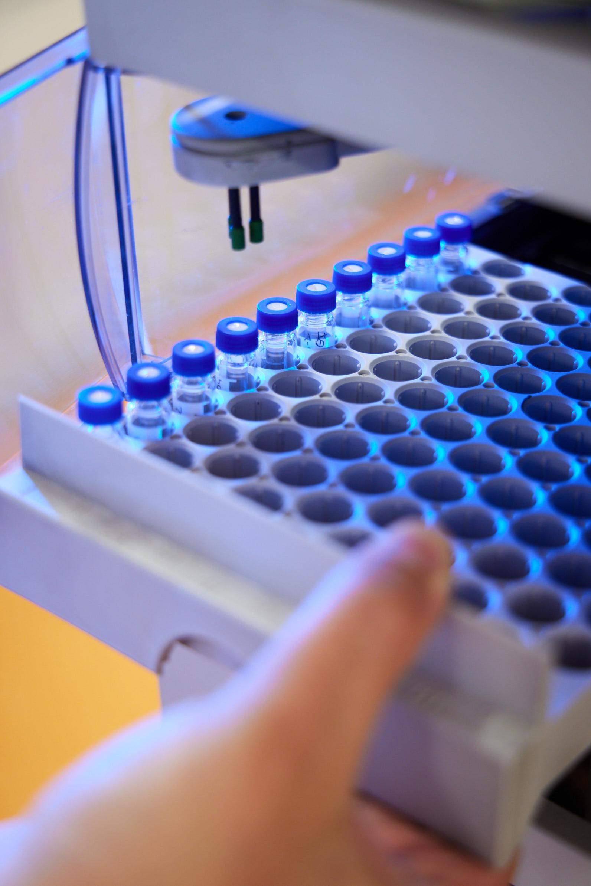
Strategy / Action Plan
Objective & Context : Compliance, treatability, traceability, risk & impact assessment, modelling, …
Type of samples : water, products, air, solids…
Molecules of interest, New Monitoring strategy
Data interpretation and visualization
Dynamic dedicated Dashboard
Data interpretation vs standard, regulation, contractual agreement
Recommendations
04
From field to field
01
03
Sampling
Where : Geography, activities,
When : Frequency, seasonality
How : Spot Sampling, Average Sampling,
Passive Sampling
Characterization
Chemistry : Organic / Inorganic, Target (pharma, ED, PAH,...), Suspect screening
On-site measurements
Physics, mechanics
02

Slide 5
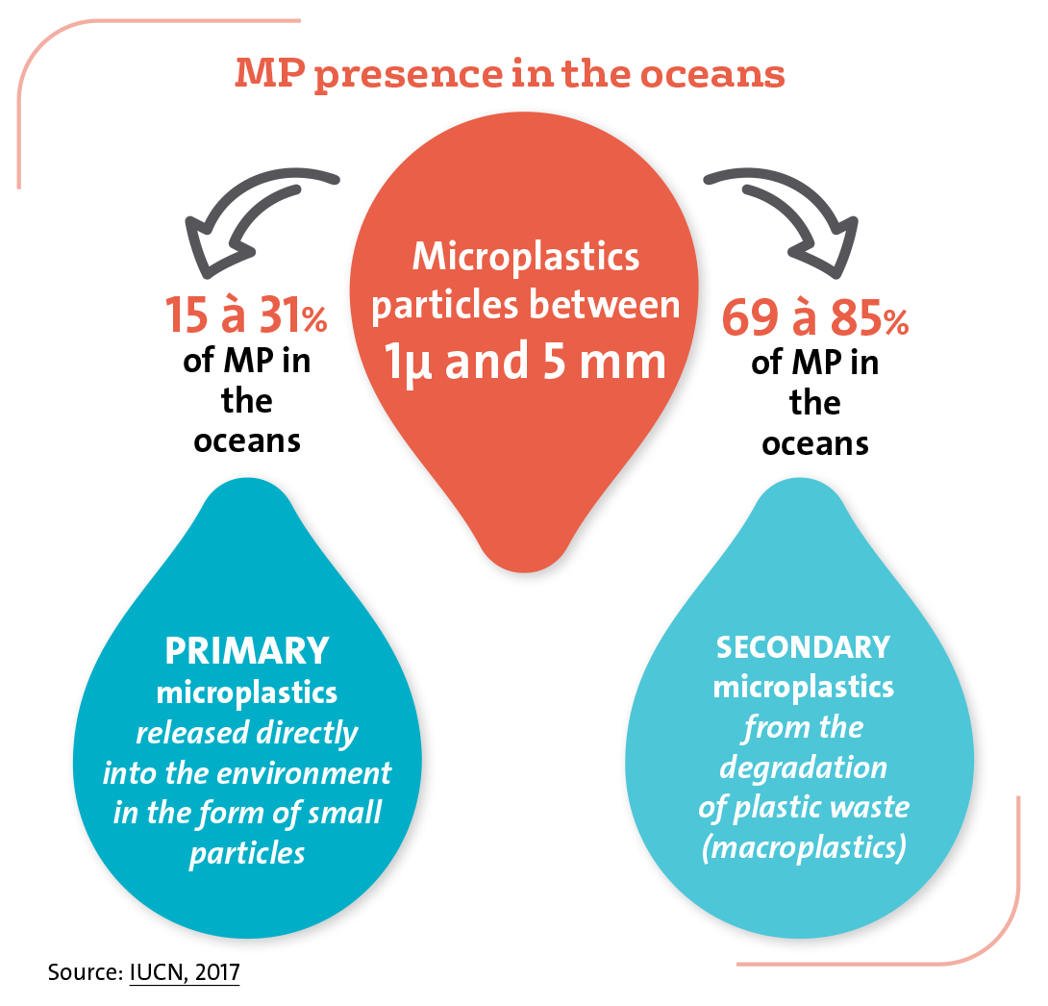
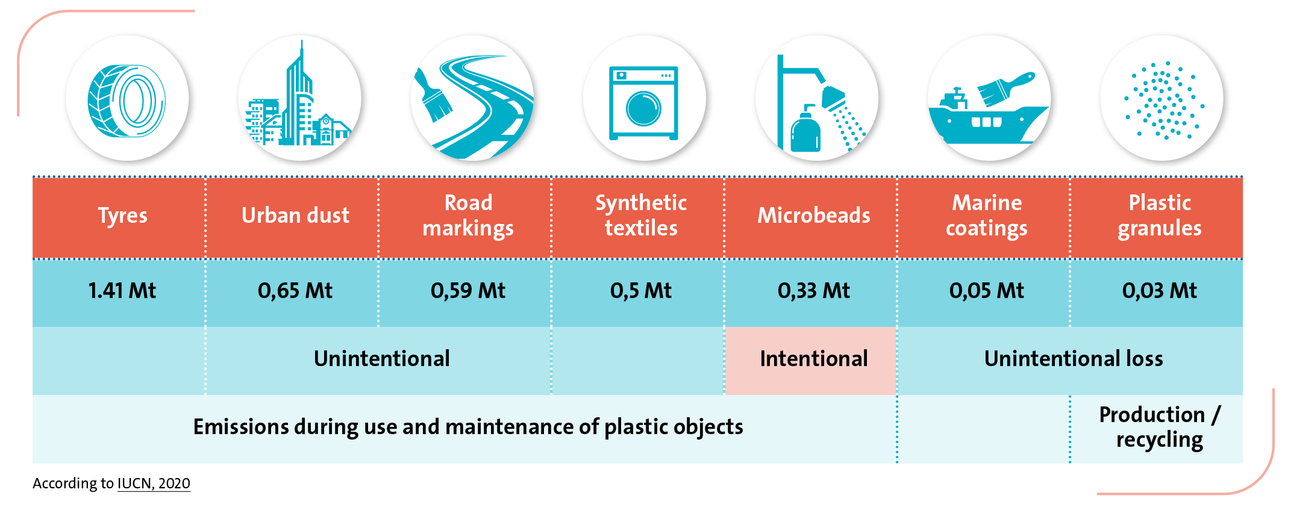
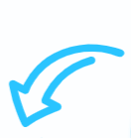
Microplastics, an invisible pollution…
An ubiquitous pollution of oceans and freshwater
15 to 31%
69 to 85%
1 µm and 5 mm
Primary microplastics sources

Slide 6

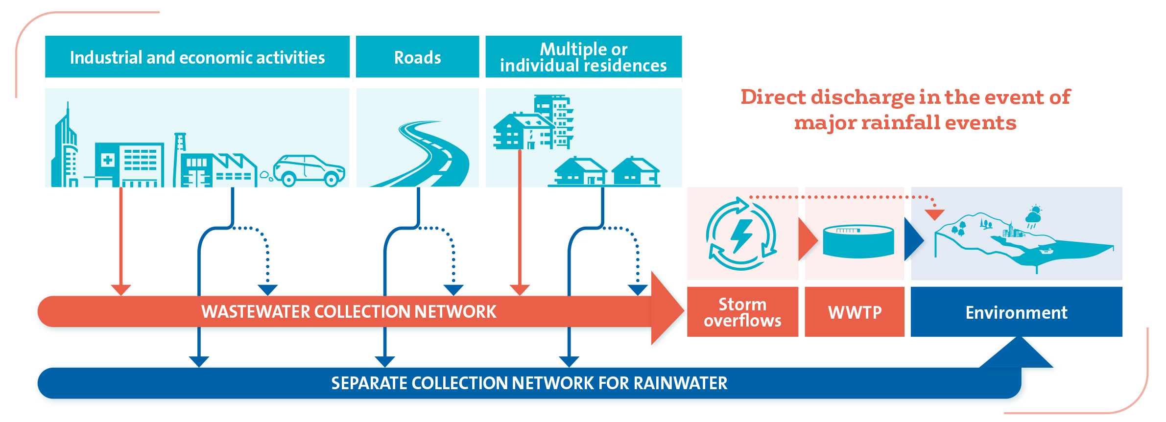
Looking at MPs on a territory

Slide 7
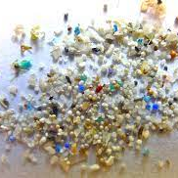


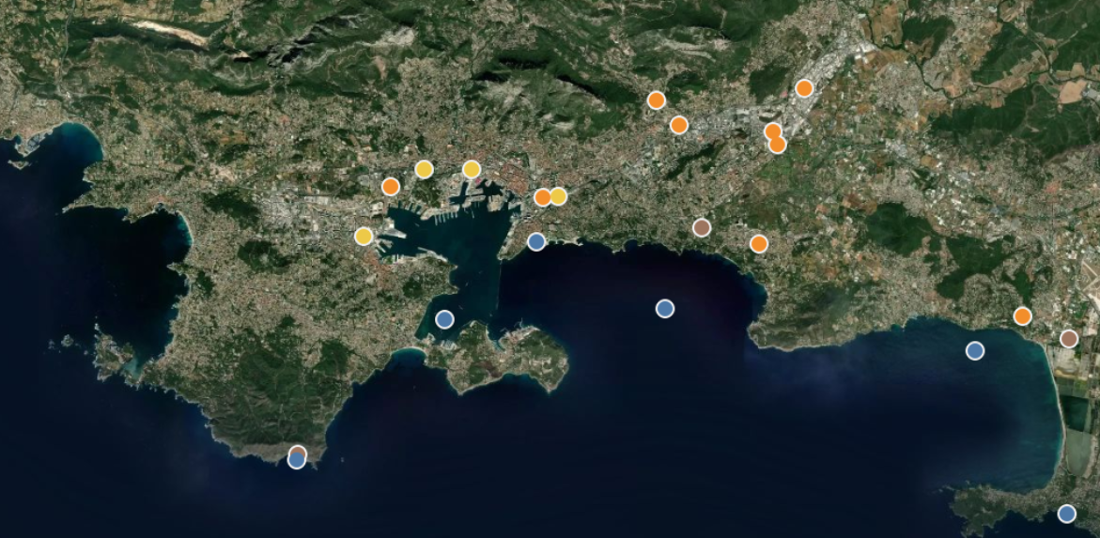


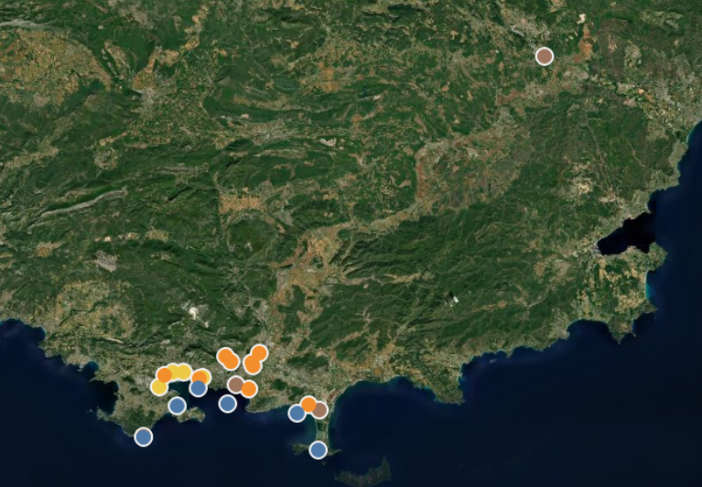
Looking at MPs on a territory
Case study: Toulon bay
MEDITPLAST project (2019-2023)
Veolia Eau
Région Méditerranée
Sea water
Wastewater network
WWTP
Stormwater

Slide 8
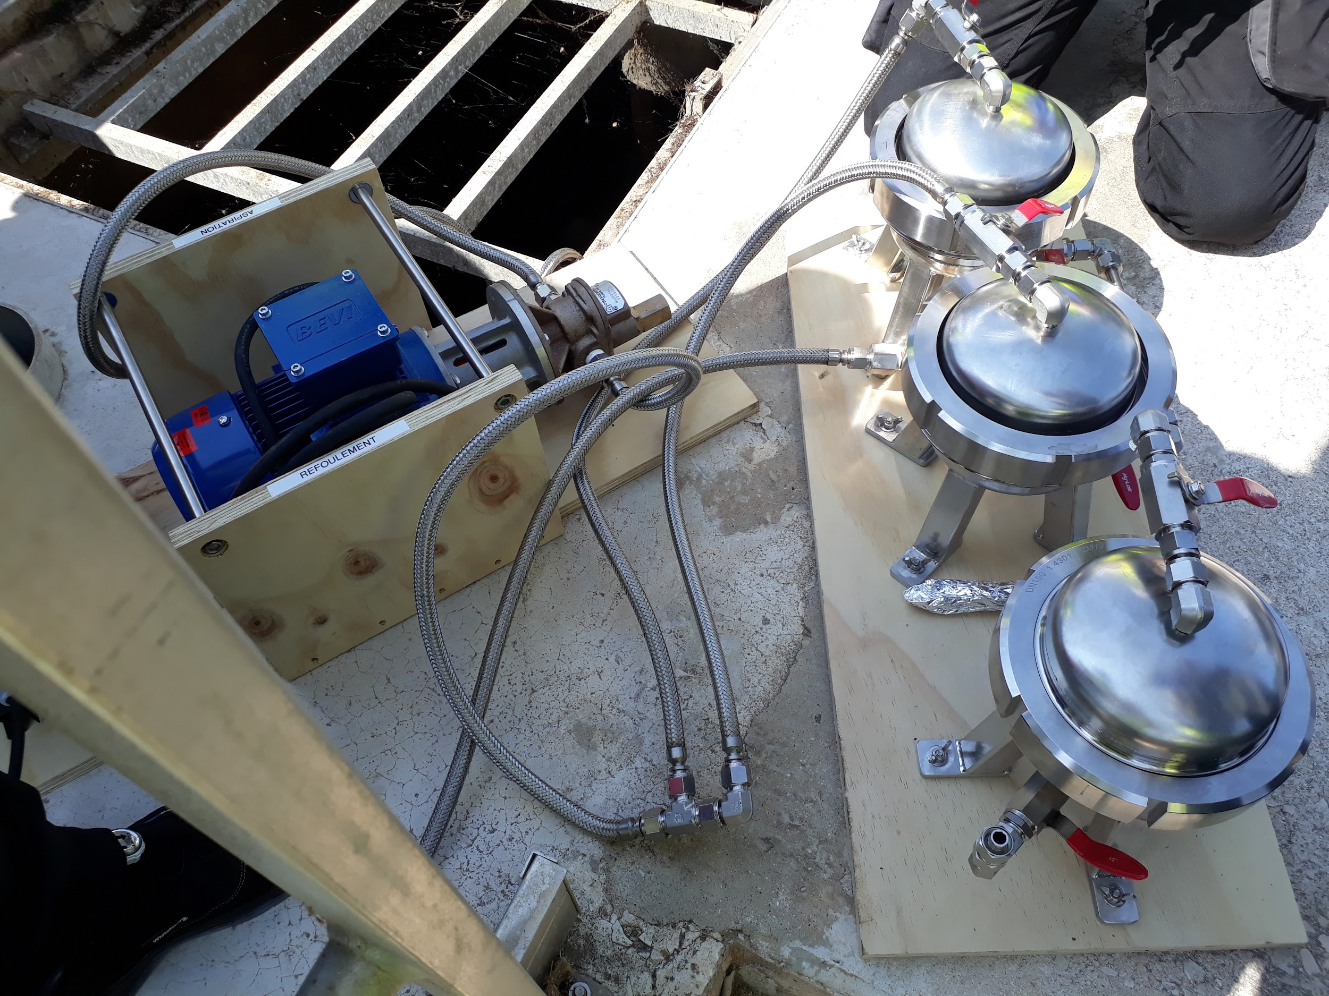
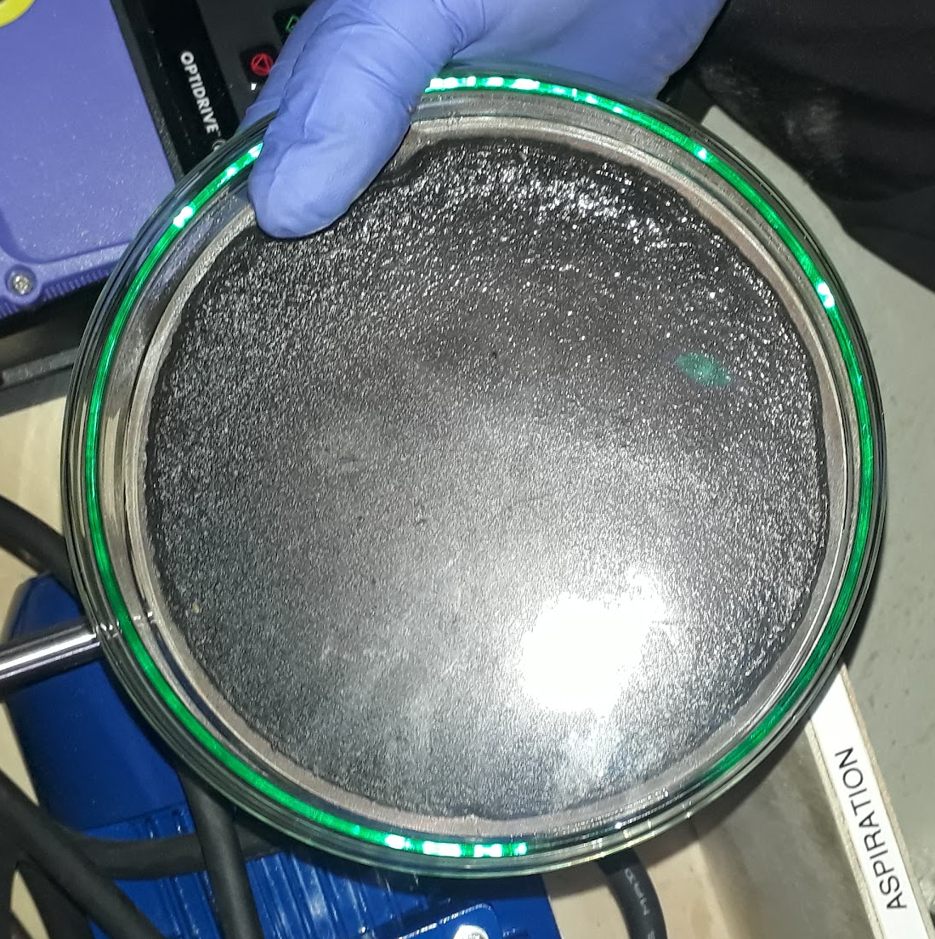
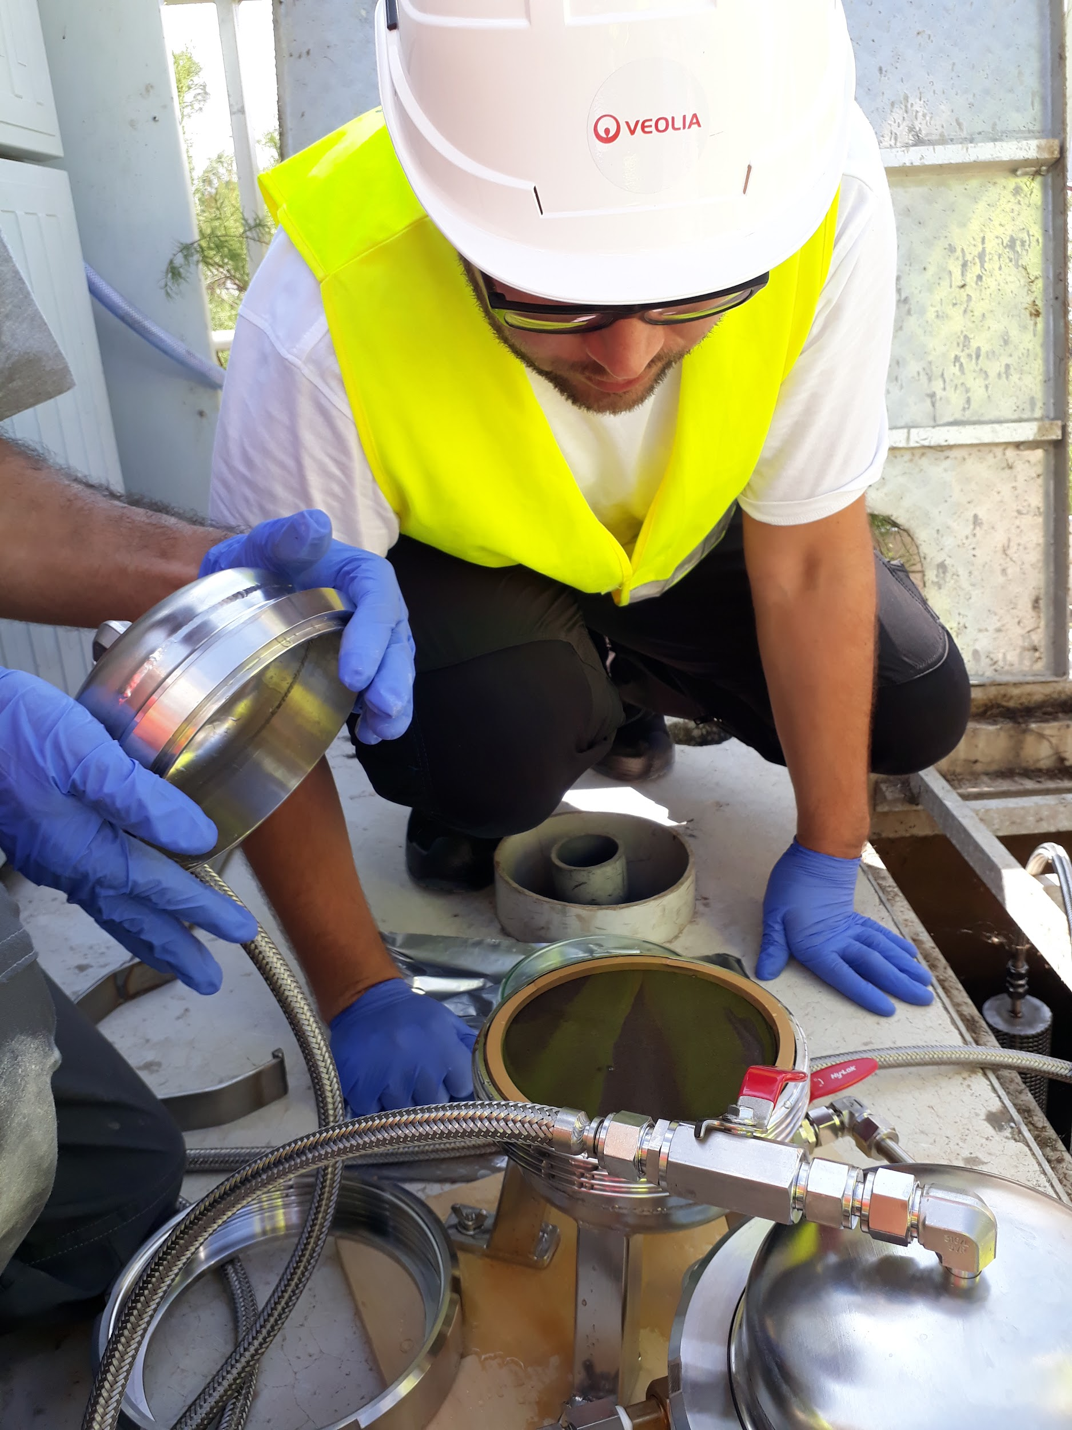
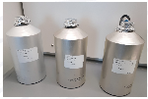
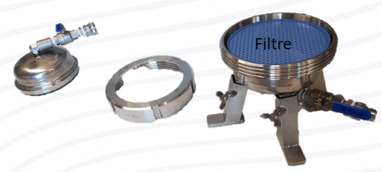
A robust and proven MP sampling strategy …
Bulk sampling
Raw (inlet) wastewater
Wastewater networks
Stainless steel dedicated tools for Large volume sampling
Water in treatment
Treated wastewater
Simon et al., (2018)

Slide 9
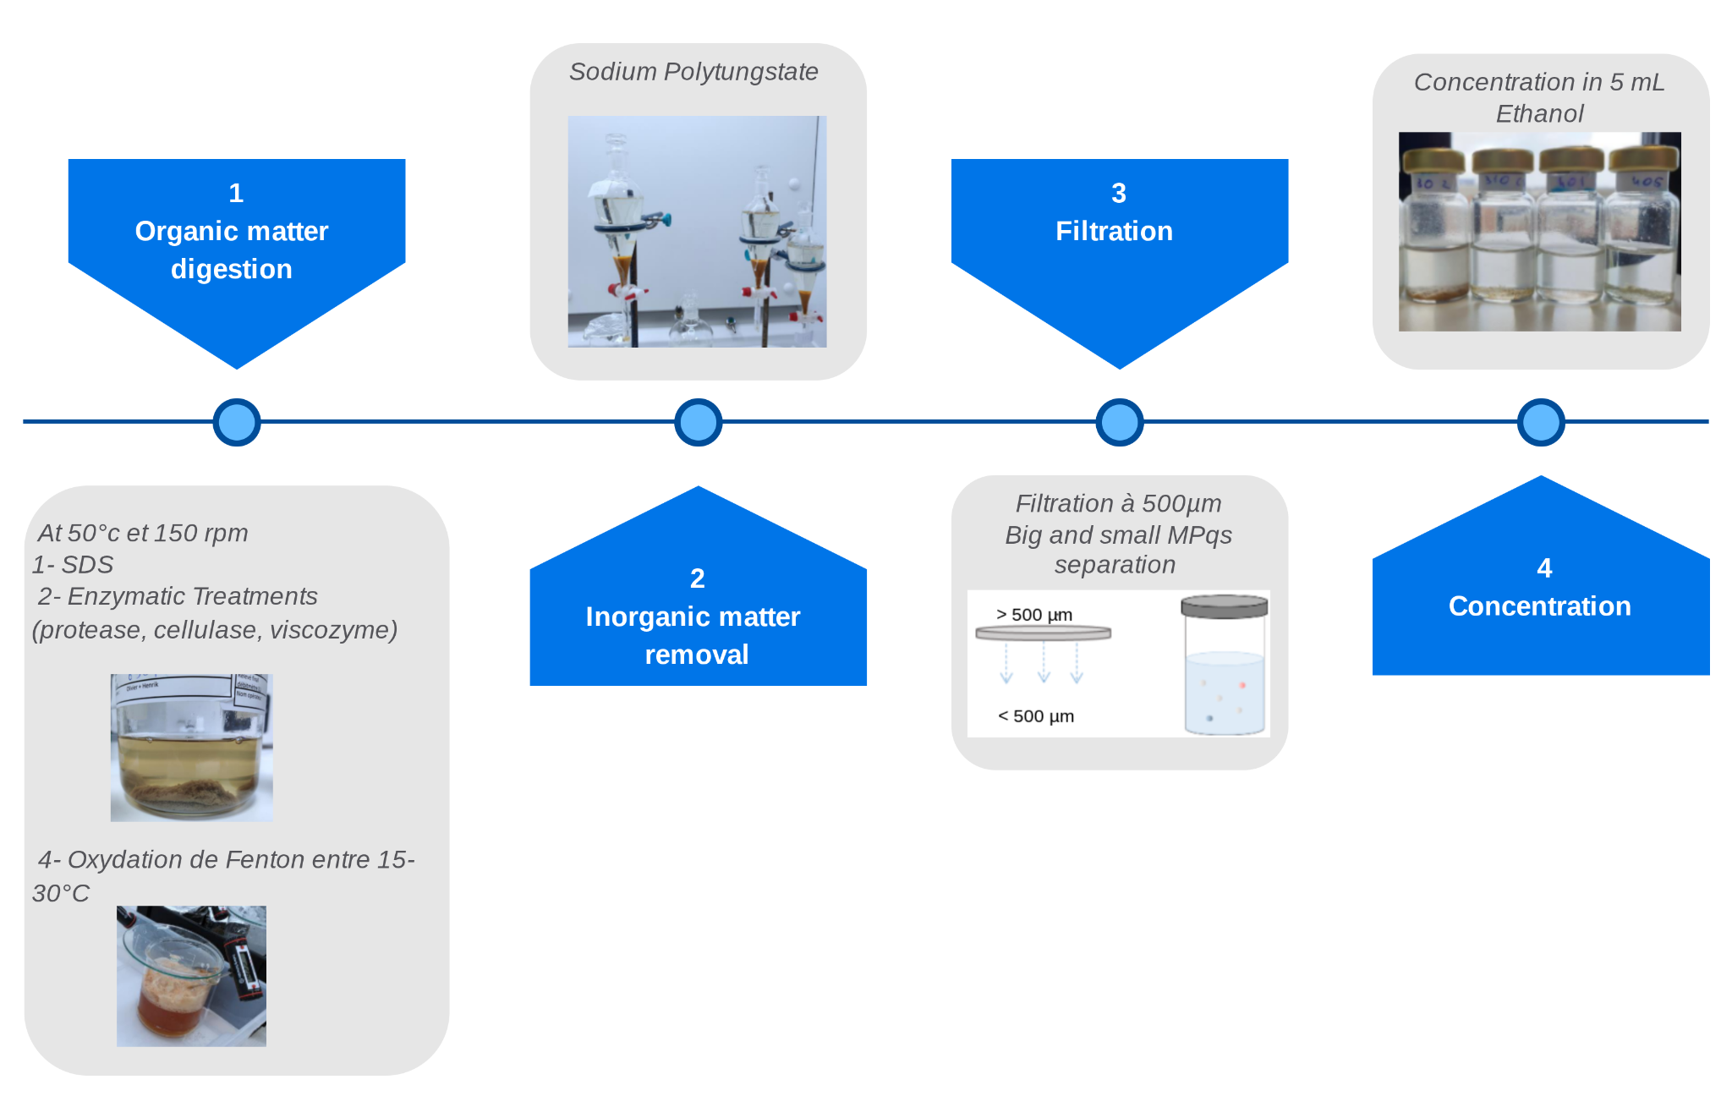
With a robust method for MP analysis
Sample preparation to remove
Natural organic matter
Inorganic matter (sand …)
Simon et al., (2018)

Slide 10
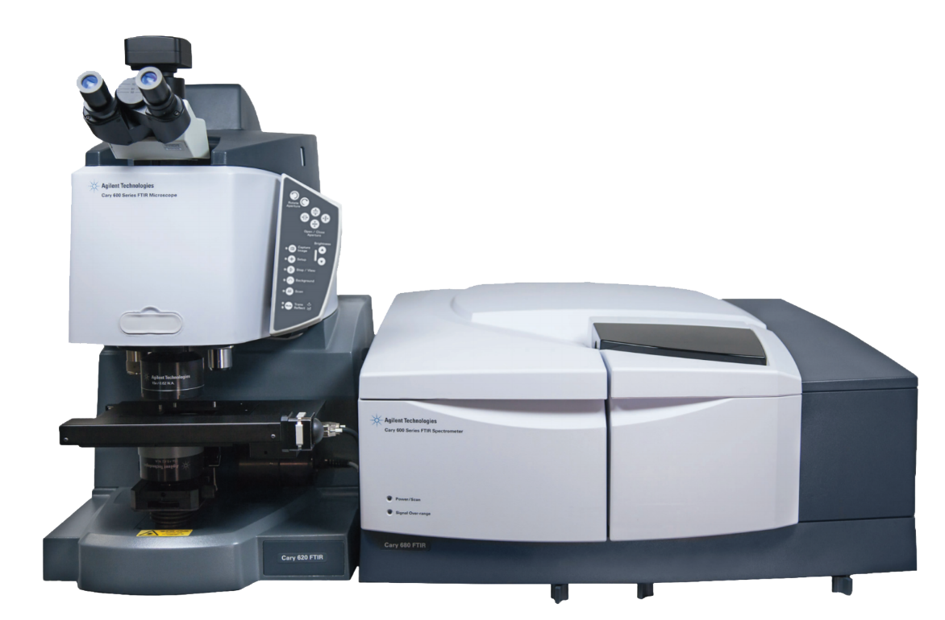
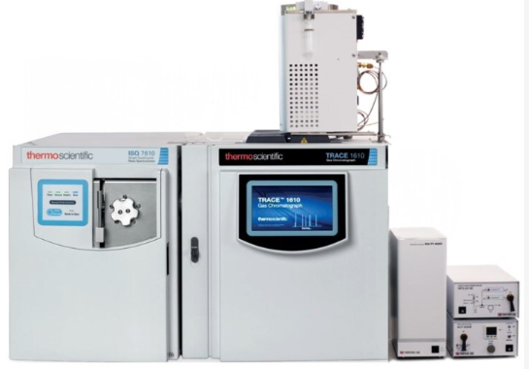
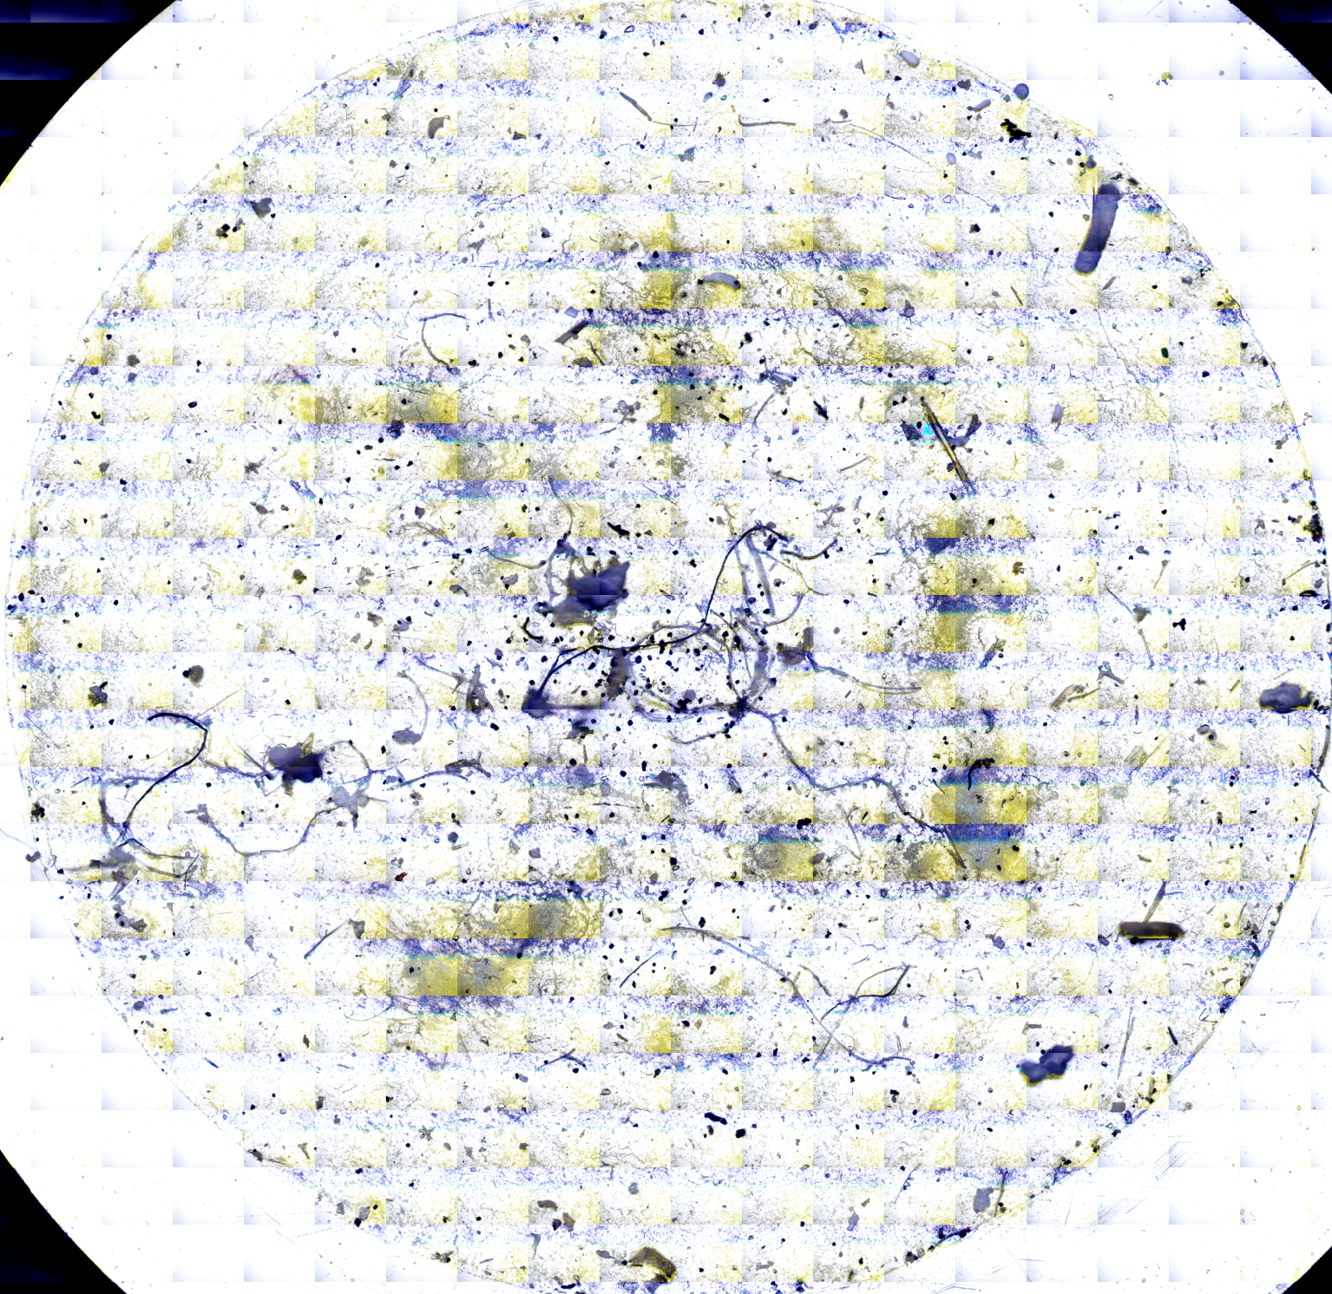
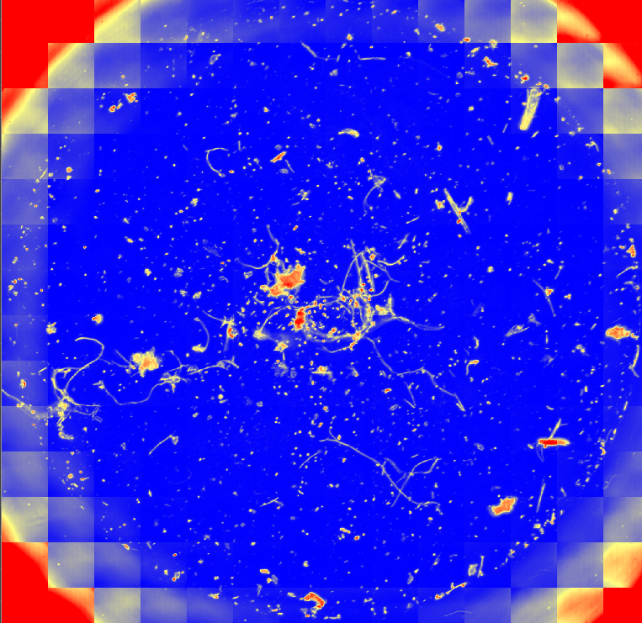
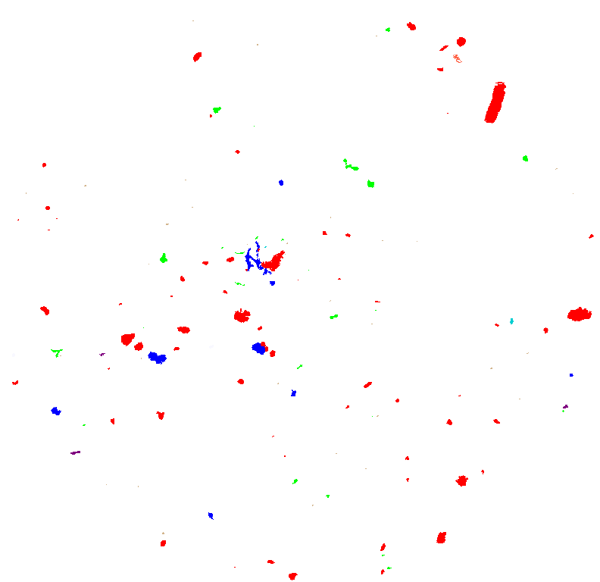
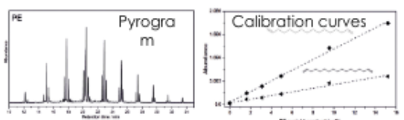

With a robust method for MP analysis
Microplastics < 500µm
Tire residues
Microscope FTIR
Pyrolysis GC-MS
Visual image
Infrared Image
Identified MP
Chemical nature Number of particles
Form & Size
(mass estimation)
Masse conc of each plastic
Aalborg University, Denmark
Alfred Wegener Institute, Germany
https://simple-plastics.eu/
Agilent
Microscope FTIR

Slide 11
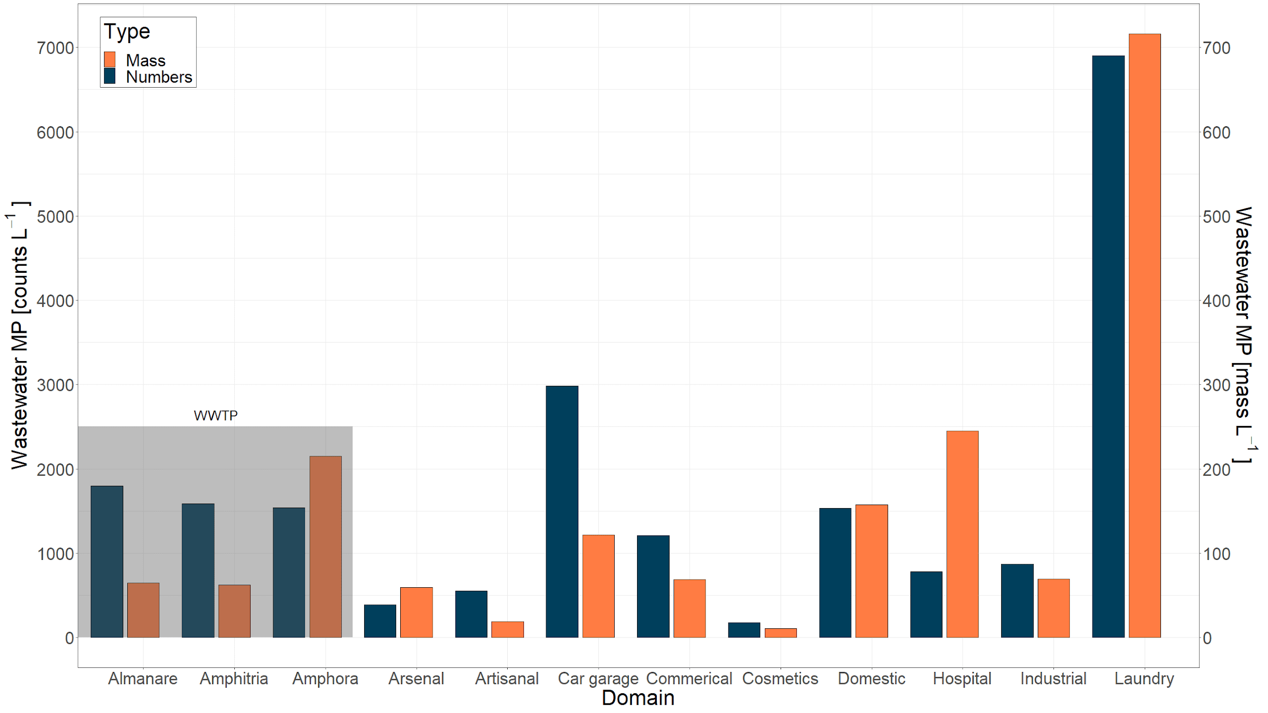
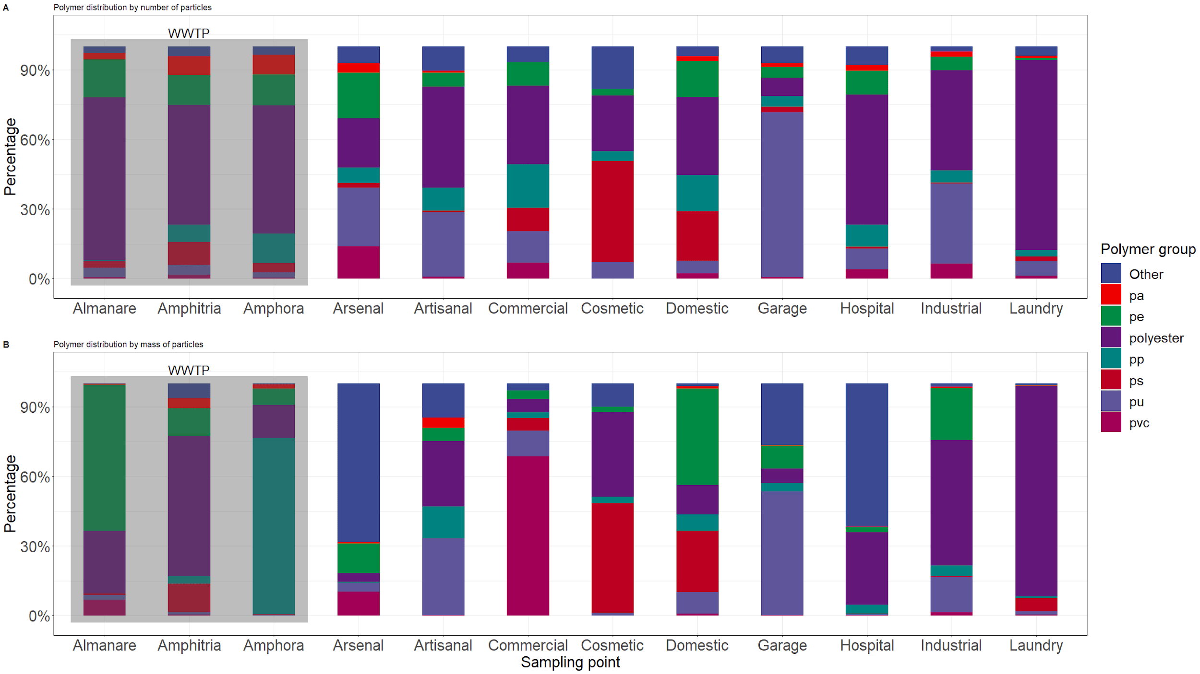
Microplastics in wastewaters networks…
…. a pollution linked to human activities
Significant impact of the nature of the economic activity on the quantity and nature of MPs
[µg.L⁻¹]
%age distribution by MASS of particles
Percentage distribution by NUMBER of particles
WWTP1
WWTP2
WWTP3
Arsenal
Artisanal
Car garage
Commercial
Cosmetics
Domestic
Hospital
Industrial
Laundry
WWTP2
WWTP1
WWTP3
Arsenal
Artisanal
Car garage
Commercial
Cosmetics
Domestic
Hospital
Industrial
Laundry
Limit MP emissions at the source
(Iordachescu L. et al. (2024), Water Res., 257, 121696. https://doi.org/10.1016/j.watres.2024.121696)

Slide 12



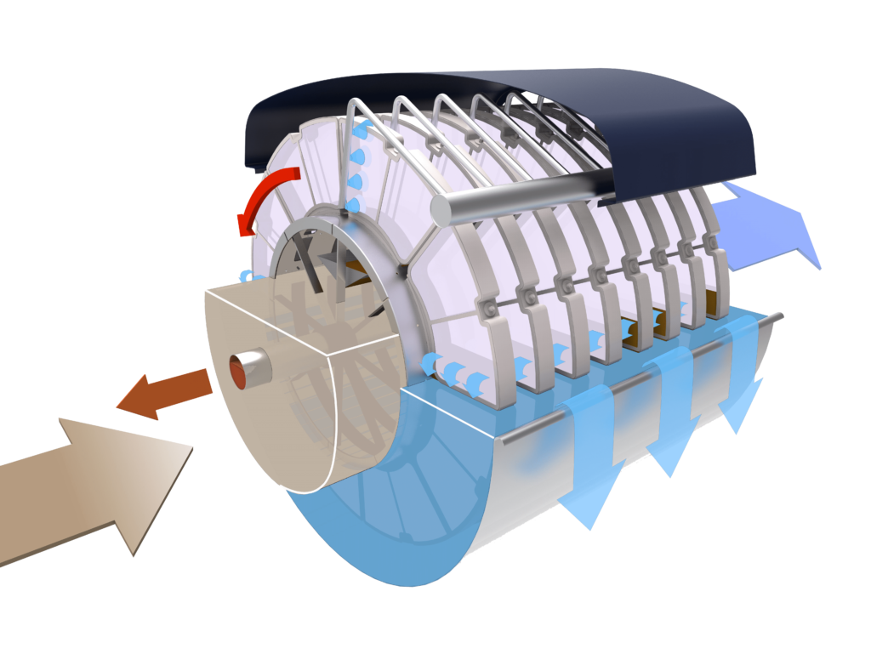
YES! WWTPs are efficient to remove MPs
Very good performances assessed in all 3 campaigns
Pre-treatment
Primary treatment
Biofiltration
109 - 1,789
MP/L
Coag/Floc.
Lamellar settler
1 - 19
MP/L
1 - 8
MP/L
Sand and oil removal
43.3-50%
MultifloTM
Densadeg
99-99.8%
BiostyrTM
Biocarbon 67-68%
Biophor
98.9 - > 99.9%
OVERALL WWTP REMOVAL EFFICIENCY: 99-99.9%
Pre-treatment
Conventional Activated Sludge
3ary treatment
444 - 1,840
MP/L
Coag/Floc.
Settler
4.6-57⁽*⁾
MP/L
2 - 40⁽*⁾
MP/L
Sand and oil removal
98.7 - 99.8%
HydrotechTM
Disc filter: 64%
Barritaud L. et al. (2022), Techniques Science Méthodes, 6, 73.
Iordachescu L. et al. (2024), submitted in Microplastics and Nanoplastics
⁽*⁾ High values = process troubleshootings
→ 90% overall WWTP removal efficiency

Slide 13

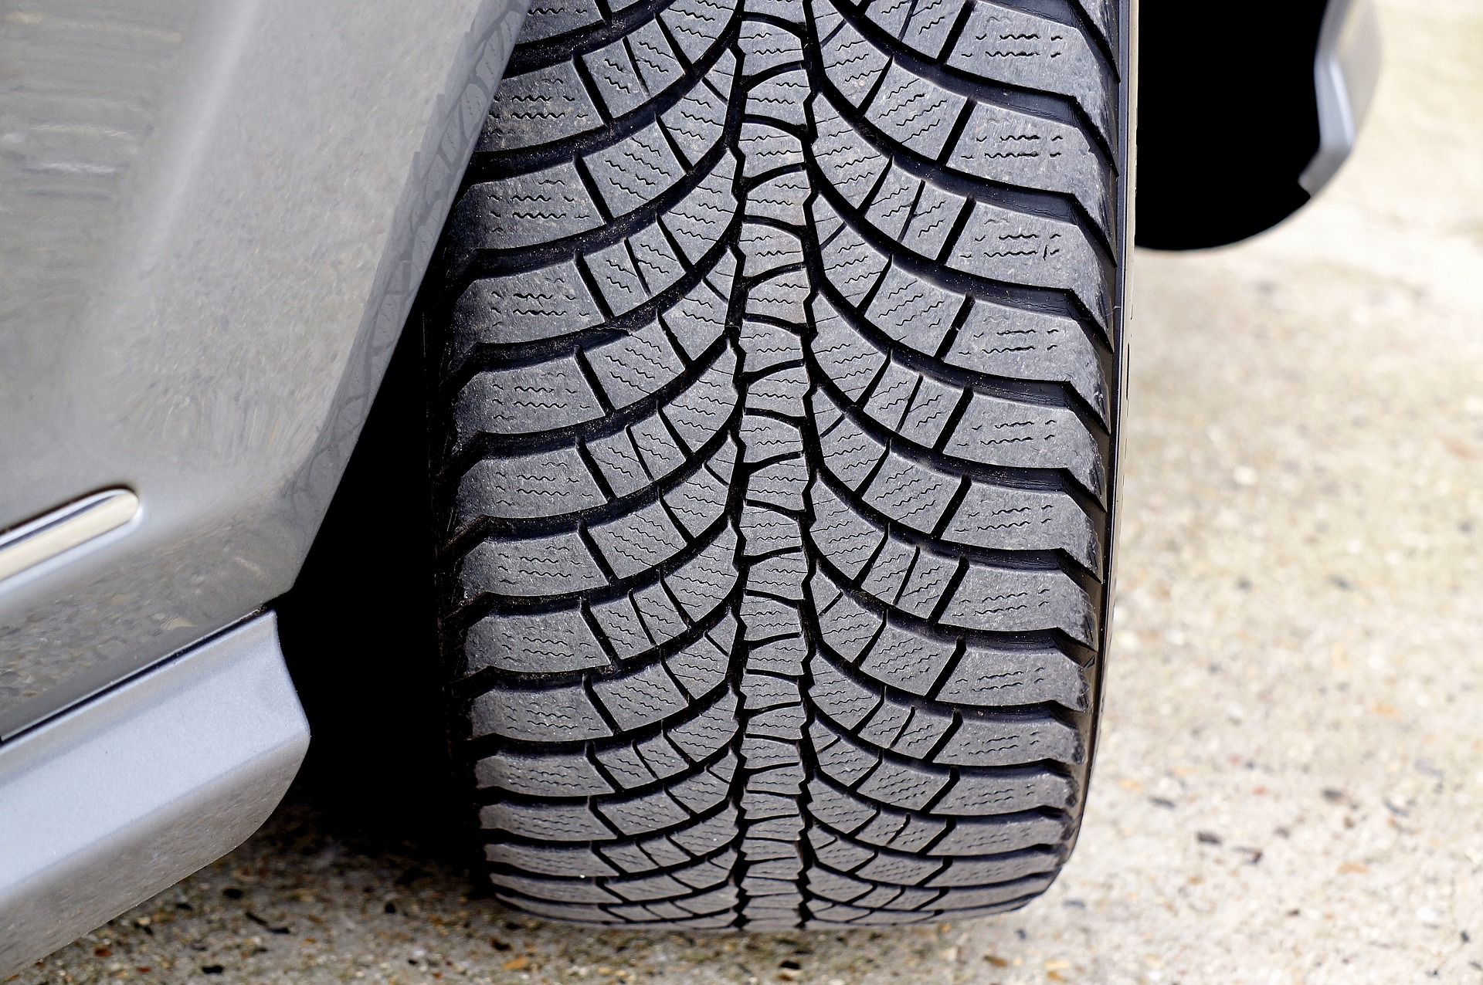
Don’t underestimate stormwater…
30,216,000 m³/y
3 WWTPs
Zones 2 to 4
14,500,000 m³/y
→ 24% annual rain
4 kg
10 kg
45 kg
555 kg
Rainwater = a major source !
Major impact = Tire residues

Slide 14
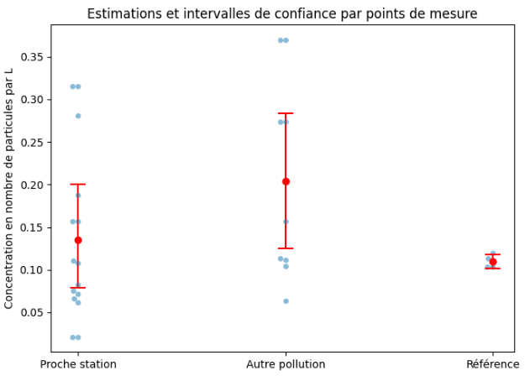
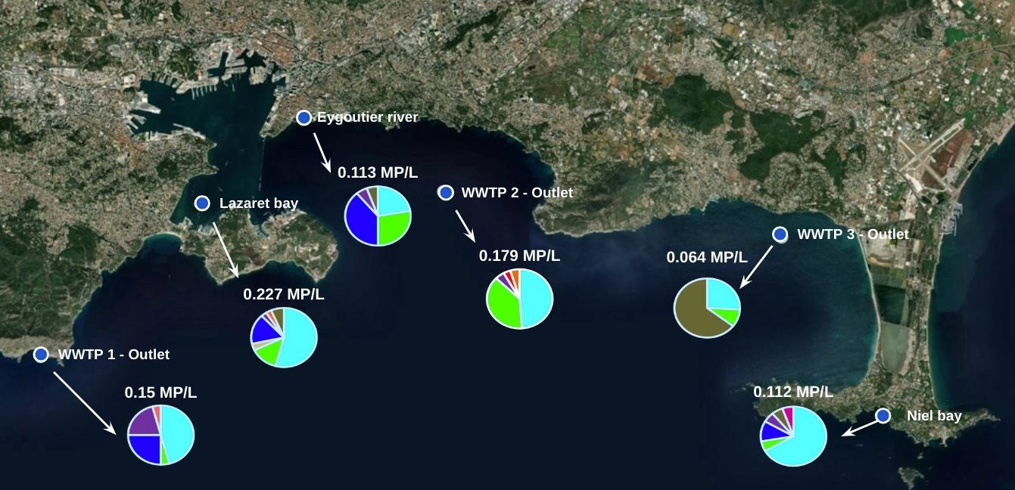
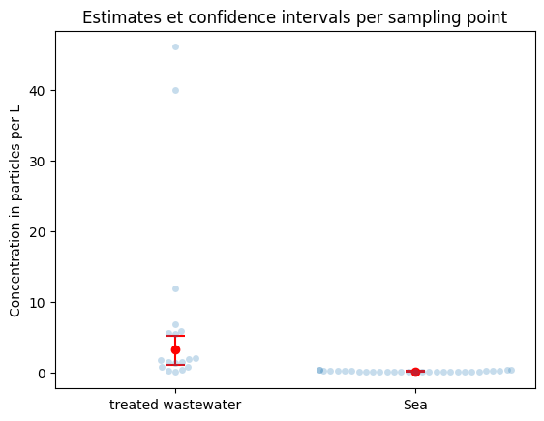
Impacts of WWTPs on the sea
3 marine campaigns
Estimates and confidence intervals per sampling point
Low levels
of MPs
Sept.’2020 campaign
Concentration in particles per L
Close to WWTP
Other pollution
(Eygoutier, Lazaret bay)
Reference
(Niels)
Estimates and confidence intervals per sampling point
Dilution effect
Treated wastewater
Sea
(“Microplastic inventory in a Mediterranean coastal sea water”. → Paper to be submitted).

Slide 15
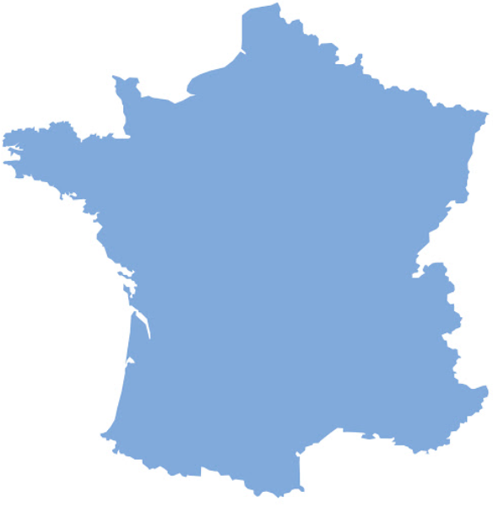
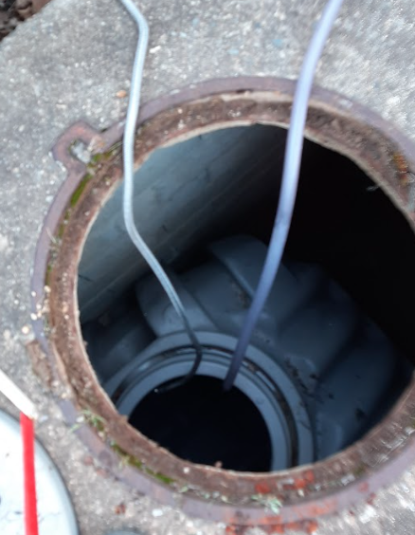
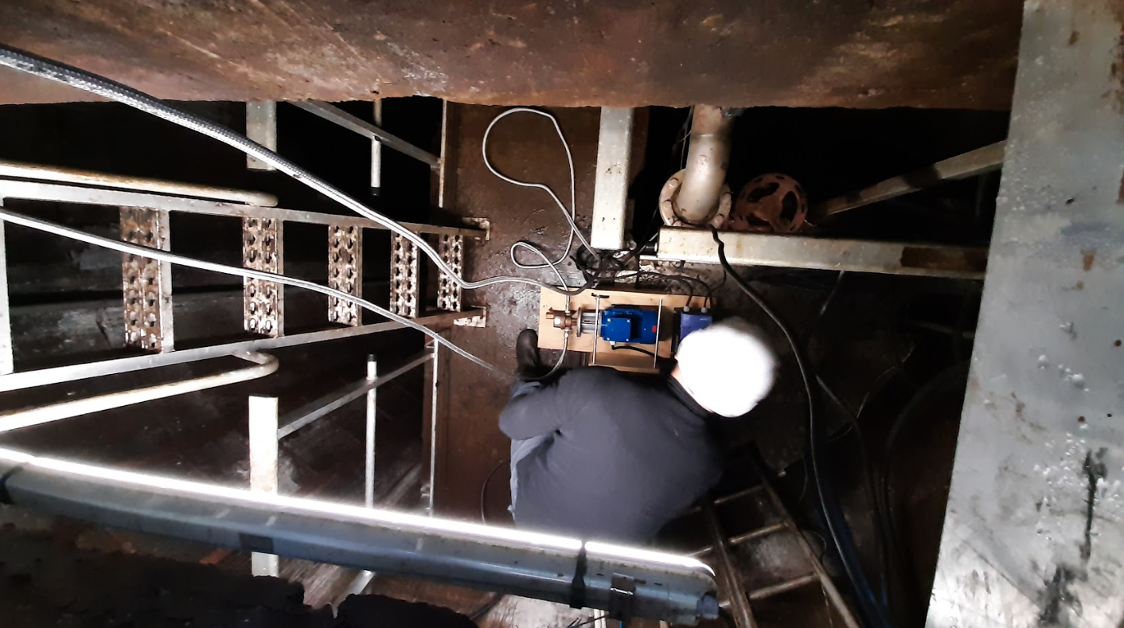
What about drinking water ?
Sample description …
1 underground water
(6 m depth) influenced by the close river
1 drinking water
Treatment: Oxidation, Mn removal by filtration, disinfection
2 underground ressources
(14 m and 72 m depth), not influenced by river (pliocene and quaternary)
Underground water 1 and 2 represent 35% of inlet water
1 drinking water
Treatment: pH correction, mineral adjustment and chloration
DWP 1
DWP 2
(“Microplastic inventory in a Mediterranean coastal sea water”. → Paper to be submitted).

Slide 16
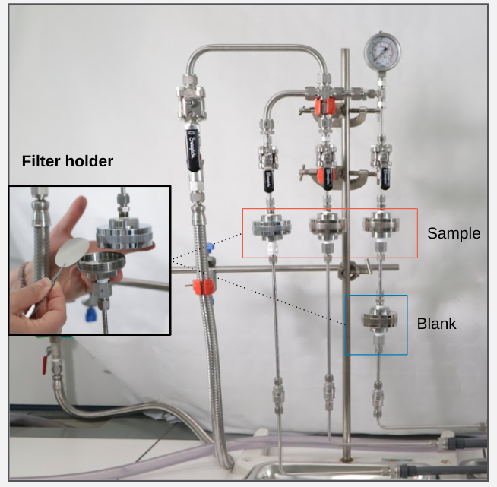
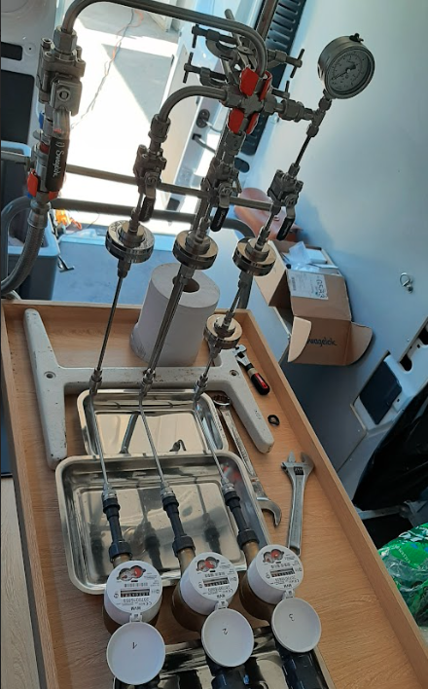
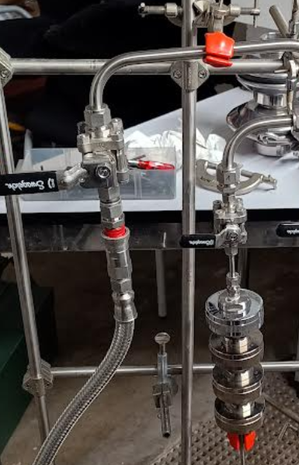
What about drinking water ?
Sampling tools
New version to fulfill European drinking water directive
2 filters Stainless steel 100µm & 20µm
Flow : 500 L/h
Pressure : 3,5 - 4 bars
5 µm pore size filter
up to 1,000L in 2hrs per sample
Integrated filter for blank sample
(“Microplastic inventory in a Mediterranean coastal sea water”. → Paper to be submitted).

Slide 17
What about drinking water ?
Results
 | Concentration MP [P/L] (> 6µm)
Underground Water DWP1 | 2.08
Drinking Water DWP1 | 0.96
Underground Water 1 DWP2 | 0.30
Underground Water 2 DWP2 | 0.01
Drinking Water DWP2 | 0.22
DWP1 : 54% removal
DWP2 : Underground water 1 and 2 represent 35% of inlet water (10 ressources for this DWP )
=> no removal rate
Small amount of MP !
More MP in DWP1 : underground water influenced by the river
(“Microplastic inventory in a Mediterranean coastal sea water”. → Paper to be submitted).

Slide 18
What should you keep in mind?
Robust and identical analytical protocols are required for reliable and comparable results => higher uncertainty than method for dissolved micropollutants
WWTPs are not a hotspot
WWTPs treat efficiently MP and tire residues. We know how to improve processes if necessary.
Reduce plastics at source
Stormwater / Untreated waters are the main stake on a territory (MPs, tire residues)
Small amount of MP in underground and drinking water

Slide 19

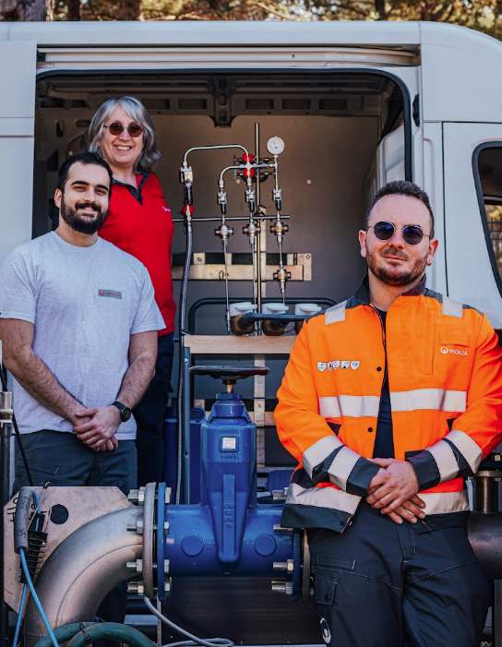
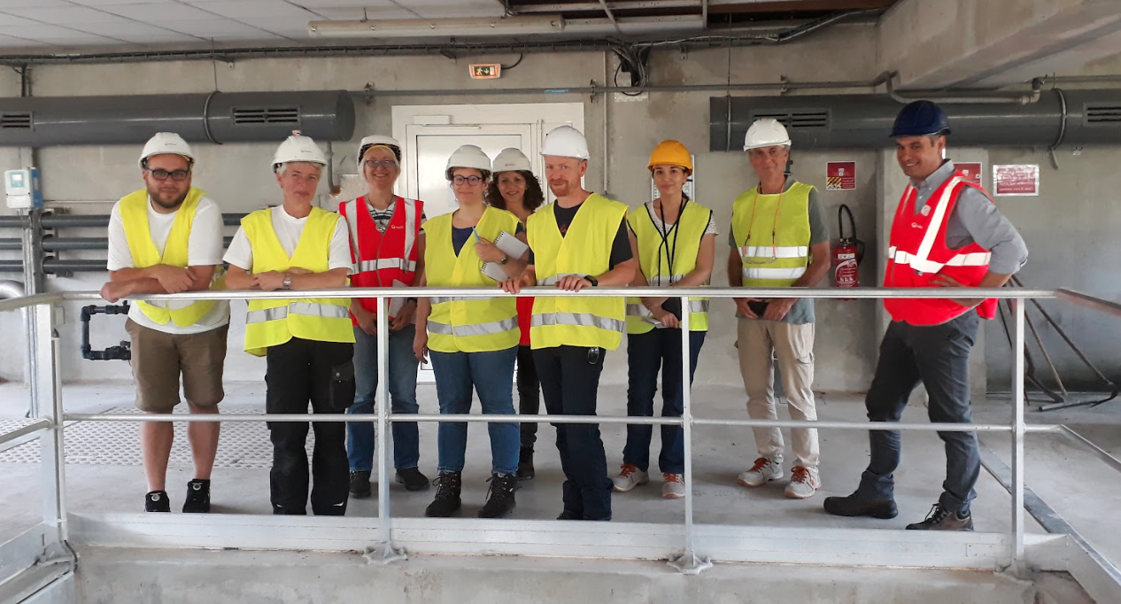
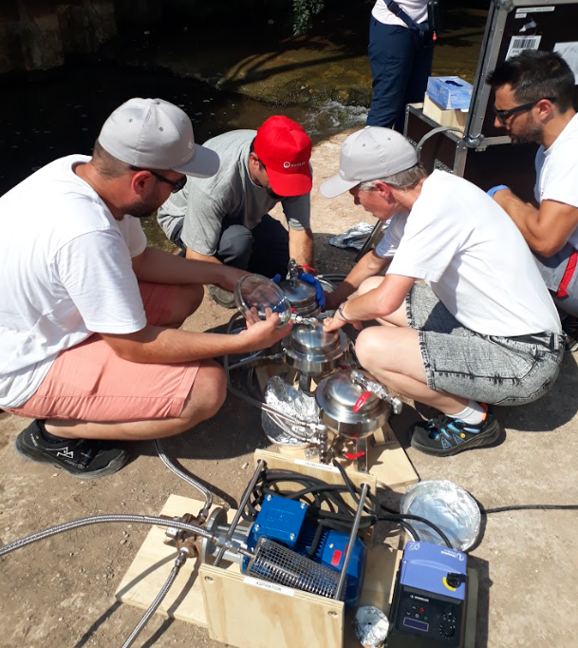
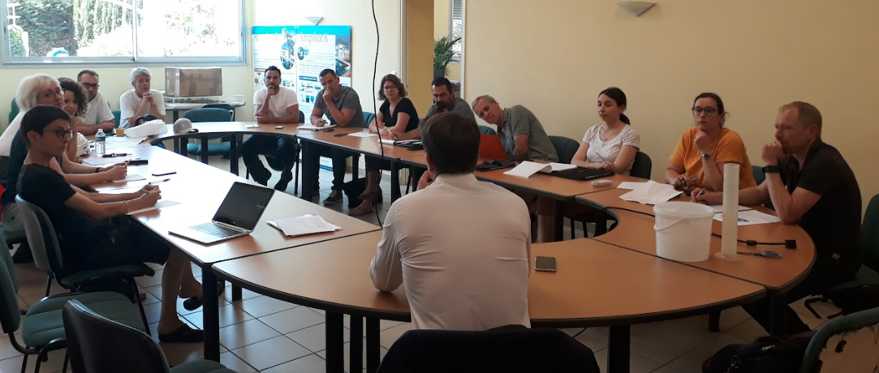
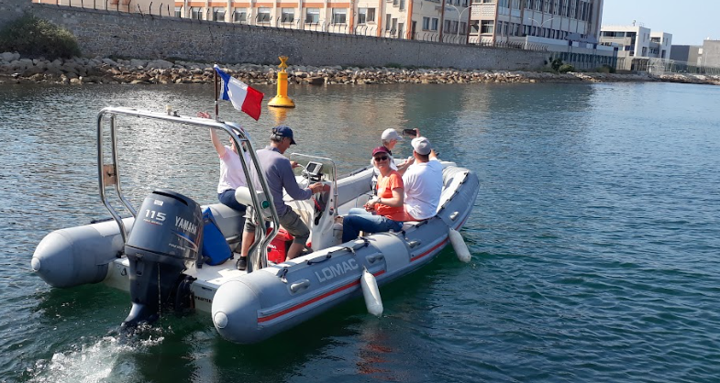
Thank you
Aalborg University (Denmark)
L. Iordachescu, K. Papacharalampos,
Prof. J. Vollertsen, C. Lorenz, M. Culina, Y. Liu
Veolia R&I (France)
L. Barritaud, M. Cormenier, M. Chachignon, V. Ingrand, M.-P. Denieul, P. Mivelaz, M. Cormenier, F. Gauthier-Fournier,
Veolia Water France
B. Bouchet, O. Royer, V. Julien, G. Baratto,
K. El Gazouli, E. Plessis, F. Poty

